Slide 1
Adversarial Search
Session 06
Henry Lucky, S.Kom., M.Kom.

Slide 2
Learning Outcomes
Session 05
At the end of this session, students will be able to:
LO 2: Apply various search algorithms for agents to solve problems

Slide 3
Outline
Session 05
Introduction
Optimal Decision in game
Alpha-beta Pruning

Slide 4
Introduction

Slide 5
Introduction
Definition
Multi-agent environment:
  Cooperative
  Competitive → Adversarial search in games
AI Game theory (combinatorial game theory):
  deterministic/ stochastic
  Turn taking
  Two players
  Zero sum games = utility values equal and opposite
  Perfect/ imperfect information
  Agents are restricted to a small number of actions described by rules

Slide 6
Introduction
Definition
Classical (economic) game theory: includes cooperation, chance, imperfect knowledge, simultaneous moves and tends to represent real-life decision making situations.
Type of Games:
 | deterministics | Chance
Perfect information | Checkers, Othello, chess | Monopoly
Imperfect information | Battleship, blind tic tac toe | Bridge, poker, scrabble

Slide 7
Introduction
Games vs search Problem
Unpredictable” opponent → solution is a strategy/policy
specifying a move for every possible opponent reply → contingency strategy
Optimal Strategy: the one that leads to outcomes at least as good as any other strategy when one is playing an infallibile opponent
Search problem: game tree
  Initial state
  Successor function: game rules
  Terminal test ( is the game over?)
  Utility function, gives a value for terminal noded (eg, +1, -1, 0)
Terminology:
  Two players called Max and Min
  Max searches the game tree
  Ply: one turn (every player moves once)

Slide 8
Minimax Algorithm

Slide 9
Minimax Algorithm
Optimal decisions in game
In a normal search problem, the optimal solution would be a sequence of actions leading to a goal state​
In adversarial search, MIN has something so say about it​
  MAX must find a contingent strategy​
  An optimal solution of MAX is the move that MIN has the worst of optimal solutions​
This definition of optimal play for MAX assumes that MIN also plays optimally—it maximizes the worst-case outcome for MAX.​

Slide 10
Minimax Algorithm
Optimal decisions in game
Terminal positions, where MAX wins (score: +infinity) or MIN wins (score: -infinity). ​
  The ply of a node is the number of moves needed to reach that node (i.e. arcs from the root of the tree).​
  The ply of a tree is the maximum of the plies of its nodes (or layer of nodes).​
​

Slide 11
Minimax Algorithm
The algorithm
Considering two-player, take turns and try respectively to maximize and minimize a scoring function and called MAX and MIN​
We assume that the MAX player makes the first move​
Represented the game as a tree where the nodes represent the current position and the arcs represent moves​
Since players take turns, successive nodes represent positions where different players must move​

Slide 12
Minimax Algorithm
The algorithm
The Minimax game strategy for the MAX (MIN) player is to select the move that leads to the successor node with the highest (lowest) score. ​
    The scores are computed starting from the leaves of the tree and backing up their scores to their predecessor in accordance with the Minimax strategy. ​
​

Slide 13
Minimax Algorithm
The algorithm
Basic Idea: choose move with highest minimax value​ = best achievable payoff against best play​
Algorithm: ​
  Generate game tree completely​
  Determine utility of each terminal state​
  Propagate the utility values upward in the three by applying MIN and MAX operators on the nodes in the current level​
  At the root node use minimax decision to select the move with the max (of the min) utility value​

Slide 14
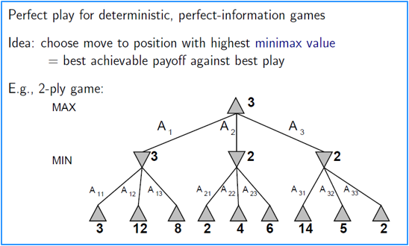
Minimax Algorithm
The algorithm

Slide 15
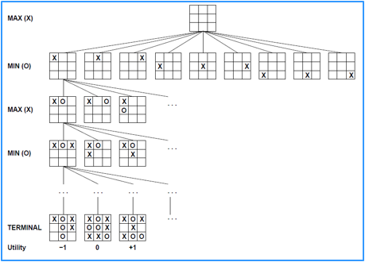
Minimax Algorithm
The algorithm

Slide 16
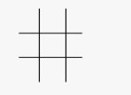
Minimax Algorithm
Example
Example: Generate game tree

Slide 17
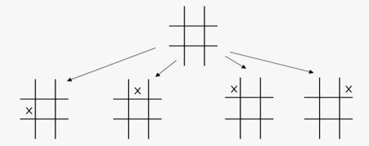
Minimax Algorithm
Example
Example: Generate game tree

Slide 18
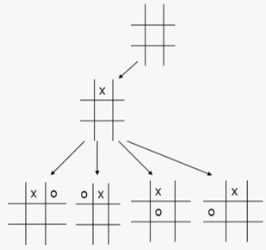
Minimax Algorithm
Example
Example: Generate game tree

Slide 19
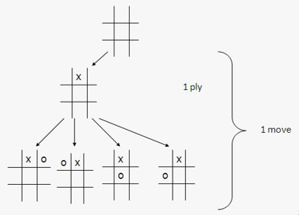
Minimax Algorithm
Example
Example: Generate game tree

Slide 20
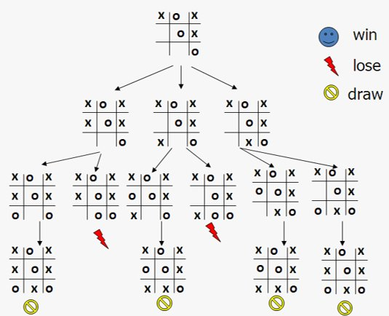
Minimax Algorithm
Example
Example: A sub tree of a game tree​

Slide 21
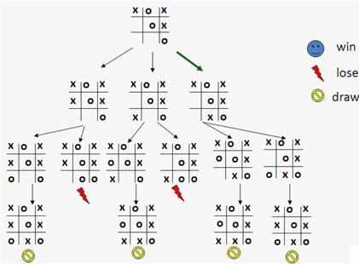
Minimax Algorithm
Example
Example: A sub tree of a game tree​

Slide 22
Alpha-Beta Pruning

Slide 23
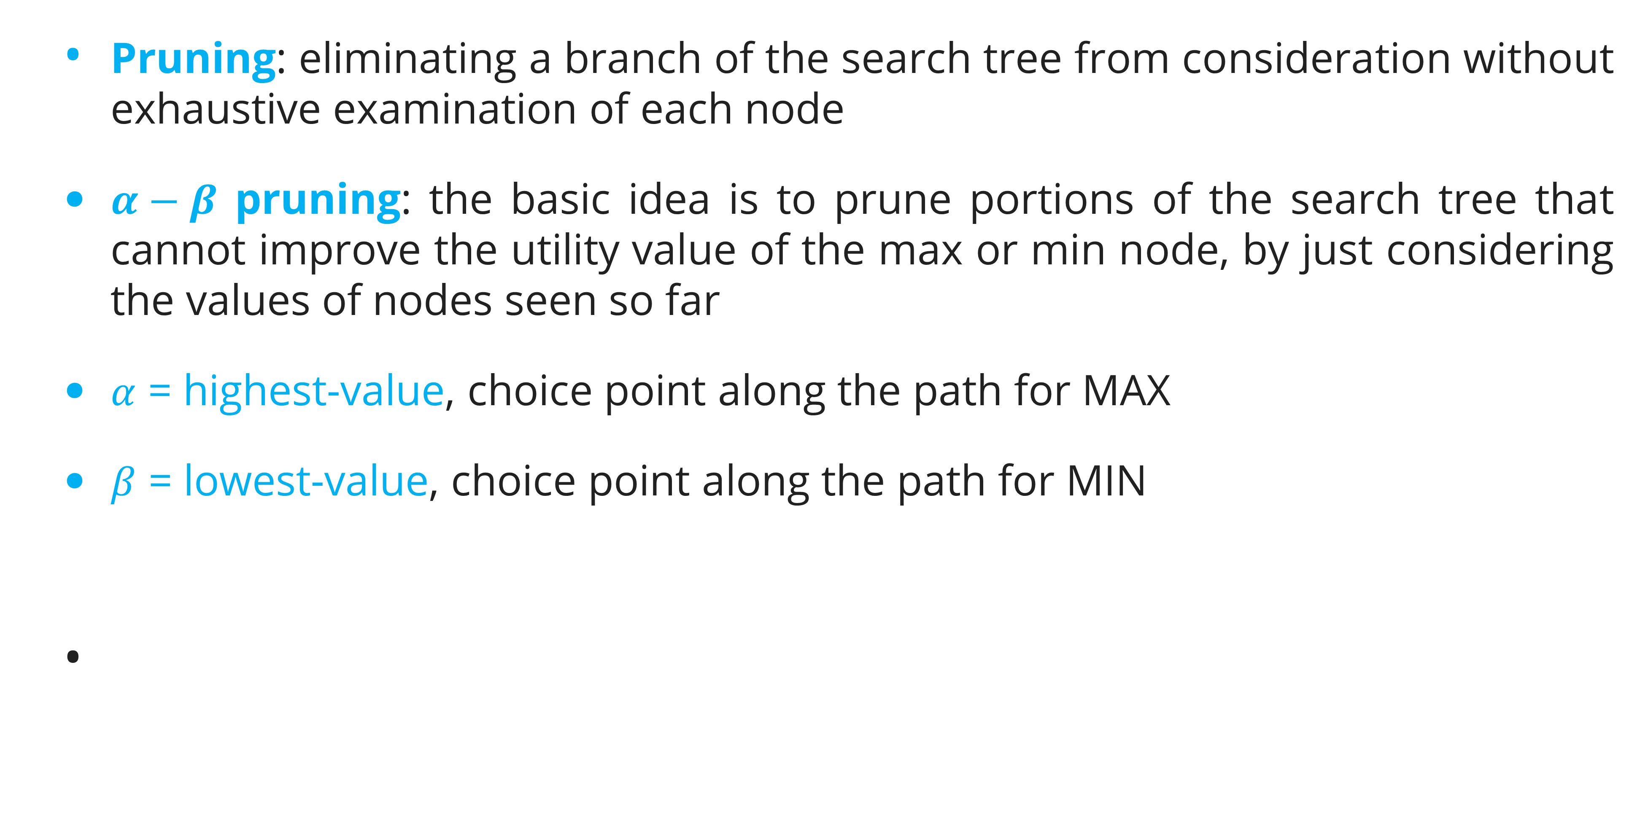
Alpha Beta Pruning
Definition
Pruning: eliminating a branch of the search tree from consideration without exhaustive examination of each node​
$α−β$ pruning: the basic idea is to prune portions of the search tree that cannot improve the utility value of the max or min node, by just considering the values of nodes seen so far​
$α$ = highest-value, choice point along the path for MAX​
$β$ = lowest-value, choice point along the path for MIN​
​

Slide 24
Alpha Beta Pruning
Algorithm
≥ 6
MAX
MIN
6
α = highest value
β = lowest value
6
12
8

Slide 25
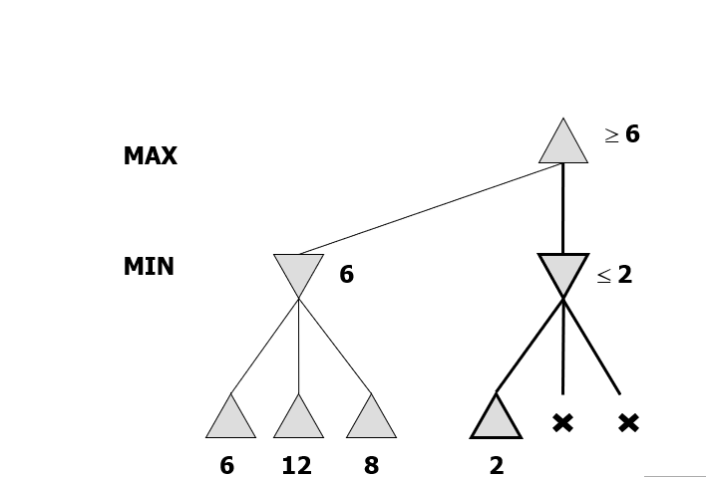
Alpha Beta Pruning
Example
Result = max(min(6,12,8),min(2,x,x))​
= max(12,min(2,x,x))​
= 12​
Note that whatever x value, it must be 2 or smaller than 2
Thus, it would not change the final result

Slide 26
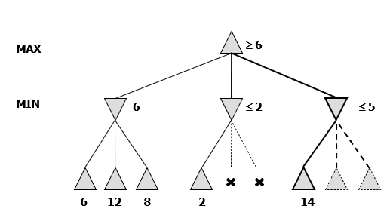
Alpha Beta Pruning
Example

Slide 27
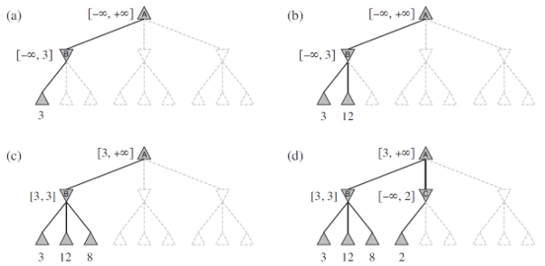
Alpha Beta Pruning
Example

Slide 28
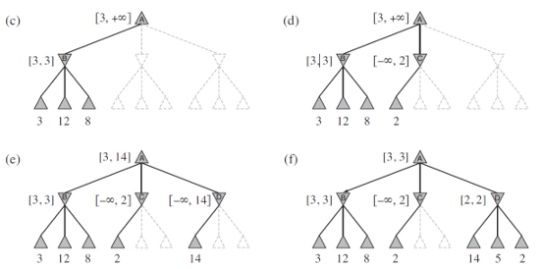
Alpha Beta Pruning
Example

Slide 29
Alpha Beta Pruning
Example
MAX
≥ 6
Selected move
MIN
6
≤ 2
≤ 5
6
12
8
2
14
5
8

Slide 30
Exercise

Slide 31
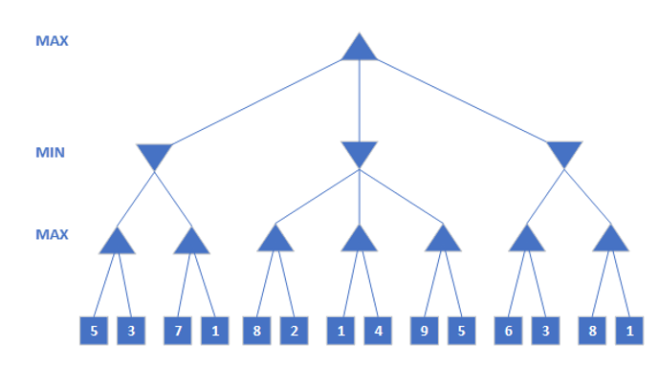
Exercise
Session 05
Given a Min-Max tree as below, describe in your own figure how the process of Alpha-Beta Pruning is executed to the tree!​

Slide 32
References

Slide 33
References
Session 05
Stuart Russell, Peter Norvig. 2020. Artificial Intelligence : A Modern Approach. Pearson Education. New Jersey
https://inst.eecs.berkeley.edu/~cs188/fa18/assets/slides/lec6/FA18_cs188_lecture6_adversarial_search_1pp.pdf
https://www2.cs.sfu.ca/CourseCentral/310/oschulte/mychapter5.pdf
https://imada.sdu.dk/u/marco/DM828/Slides/dm828-lec17.pdf

